Slide 1
The Basics of Android App Development
Sankarshan Mridha
Satadal Sengupta

Slide 2
Outline
Introduction
Android Fundamentals
Android Studio
Tutorial and Demo

Slide 3
Introduction
What is Android?
A software platform and operating system for mobile devices
Based on the Linux kernel
Developed by Android Inc., bought by Google and now managed by the Open Handset Alliance (OHA)
Allows writing managed code in the Java language

Slide 4
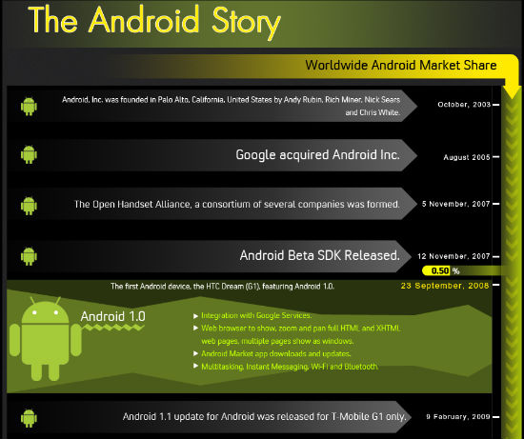

Slide 5
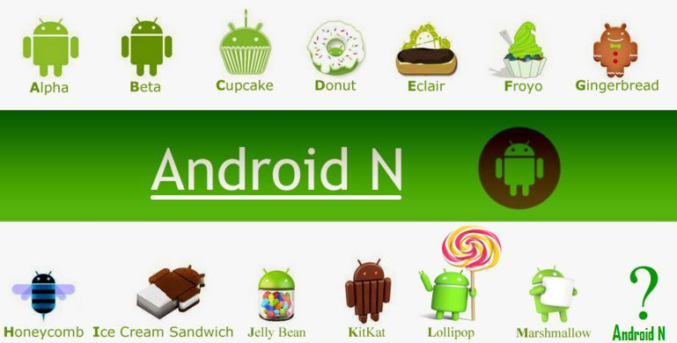
Android Versions

Slide 6
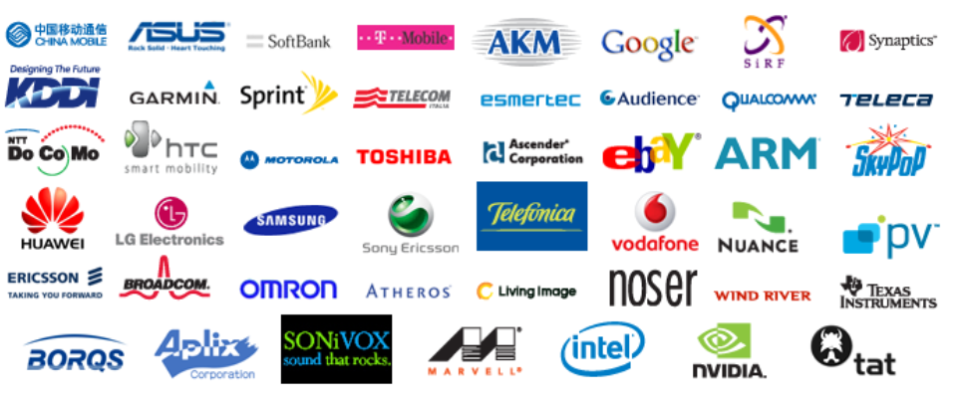
Open Handset Alliance (OHA)
“… Open Handset Alliance™, a group of 47 technology and mobile companies have come together to accelerate innovation in mobile and offer consumers a richer, less expensive, and better mobile experience. “ (from the OHA page)
Notes:
OHA:
Handset Manufactures
Mobile Operators
Semiconductor Companies
Software Companies
Commercialization Companies

Slide 7
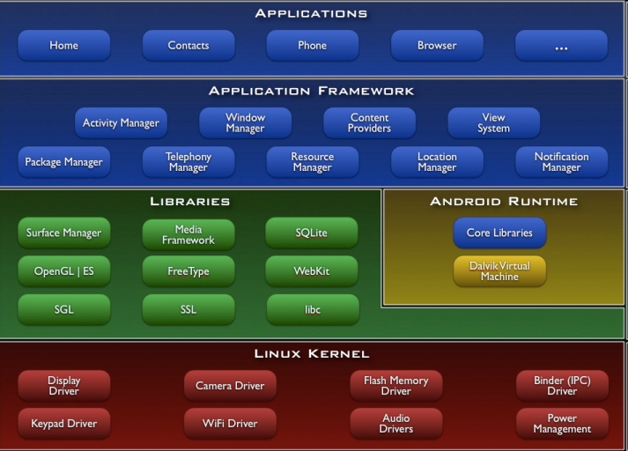
Android Architecture

Slide 8
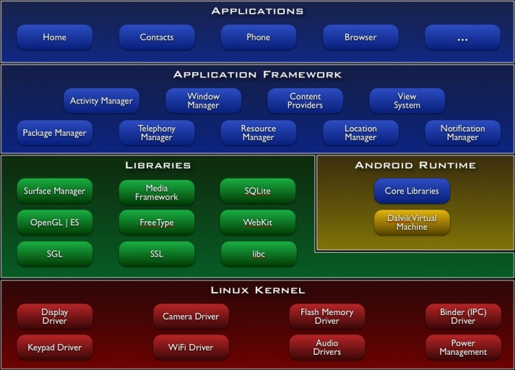
The Android Architecture
Built on top of Linux kernel (v. 2.6-3.0)
Advantages:
Portability (i.e. easy to compile on different hardware architectures)
Security (e.g. secure multi-process environment)
Power Management

Slide 9
The Android Architecture
Native Libraries
(C/C++ code)
Graphics (Surface Manager)
Multimedia (Media Framework)
Database DBMS (SQLite)
Font Management (FreeType)
WebKit
C libraries (Bionic)
Notes:
libc: C standard library
SSL: Secure Socket Layer
Surface Manager: responsible for composing different drawing surfaces onto the screen.
OpenGL|ES : 3D Image Engine
SGL : 2D image Engine. Hence we can combine 3D and 2D graphics in the same application.
Media Framework : Core part of the android multimedia.➔ MPEG4,H264,MP3,AAC…..
FreeType: To render the fonts.
WebKit: Open source browser engine. Helps to work well on small screen.
SQLite: Embedded Database

Slide 10
The Android Architecture
Dalvik Virtual Machine (VM) (Later replaced by ART)
Novel Java Virtual Machine implementation (not using the Oracle JVM)
Open License
Optimized for memory-constrained devices
Faster than Oracle JVM
Notes:
Android runtime meets the needs of running in an embedded environment ,i.e., with limited battery, limited memory and limited CPU.
CORE LIBRARIES:
Java Programming Language
contains all the collection classes, utilities, IO, all these utilities which you come across and expect to use.
DALVIK VIRTUAL MACHINE:
Java based license free VM
Optimization for low memory requirements.
DVM runs .dex files (byte codes) that converts during built time.
➔ more efficient and run very well on small processors.
➔structure are designed to be shared across processes due to which multiple instance of DVM running on device at the same time one in several processes

Slide 11
The Android Architecture
Application Libraries
(Core Components of Android)
Activity Manager
Packet Manager
Telephony Manager
Location Manager
Contents Provider
Notification Manager

Slide 12
The Android Architecture
Applications
(Written in Java code)
Android Play Store
Entertainment
Productivity
Personalization
Education
Geo-communication
Notes:
These were the “When” & “What” of Android !!
Now let’s talk “Why”??

Slide 13
Why Android Development?
Android enjoys largest market share of smart devices worldwide.
Android SDK is available for Windows, Mac and Linux.
SDK built on Java, a popular programming language.
Applications on Play Store available to huge user-base.
Rich technical documentation, and online support.

Slide 14
The Big Picture!
Write the code in Java and design layouts in XML files.
Once the app is ready, use a build tool to compile all the project files and package them together into “.apk” file.
The apk can be run on Android devices and/or submitted to Google Play.
All of the files used to put the app together are managed by an Integrated Development Environment (IDE).
The standard IDE for Android used to be Eclipse, but this is now being replaced by Google’s own Android Studio.

Slide 15
Application Fundamentals
Activities
application presentation layer
Services
invisible components, update data sources, visible activities, trigger notifications
perform regular processing even when app is not active or invisible
Content Providers
shareable data store
Intents
message passing framework
broadcast messages system wide, for an action to be performed
Broadcast receivers
consume intent broadcasts
lets app listen for intents matching a specific criteria like location
Notifications
Toast notification
Status Bar Notification
Dialog notification

Slide 16
What we will develop?
Creating a new project.
Glance at the various project components.
Moving towards input methods (UI components).
Button Dynamics.
Working App.

